Slide 1
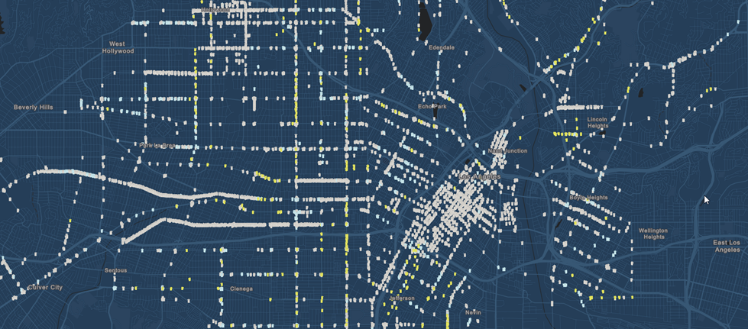
Analysis of Violent Crime in Los Angeles, CA (2010 – 2017)
Los Angeles, CA
Jon Heston, Eleanora Trittipo, Shrawantee Saha

Slide 2
Project Requirements
The technical requirements for Project 1 are as follows.
Use Pandas to clean and format your data set(s)
Create a Jupyter Notebook describing the data exploration and cleanup process
Create a Jupyter Notebook illustrating the final data analysis
Use Matplotlib to create a total of 6-8 visualizations of your data (ideally, at least 2 per "question" you ask of your data)
Save PNG images of your visualizations to distribute to the class and instructional team, and for inclusion in your presentation
Optionally, use at least one API, if you can find an API with data pertinent to your primary research questions
Create a write-up summarizing your major findings. This should include a heading for each "question" you asked of your data, and under each heading, a short description of what you found and any relevant plots.
Notes:
For now hide it. It is just for reference.

Slide 3
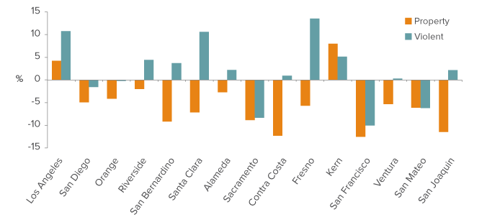
Motivation
Crime Trends in California(2016)*:
California’s violent crime rate rose in 2016—but it remains historically low.
The statewide property crime rate decreased in 2016.
Crime rates vary dramatically by region and category.
Violent crime increased in a majority of counties …
… but property crime decreased in most counties.
*Public Policy Institute of California publication (November 2017): http://www.ppic.org/publication/crime-trends-in-california/
Notes:
Note that among the 15 largest counties in CA, only Kern and Los Angeles saw both violent and property crime rates increase in 2016.

Slide 4
What are we presenting?
Focus
Los Angeles City
2010 to 2017
Analyze Violent Crime
Are certain months or years more crime prone?
Can we identify safe versus not-so-far neighborhoods?
Do demographics of the place where the crime was committed matter?
Tools
Graphs and Charts
Simple Regressions
Informative Map

Slide 5
Rest of the presentation
1. Data Sources
2. Data Cleaning
3. Description
4. Results
5. Conclusions
6. Future Work

Slide 6
1. Data Sources
Incidence of Crime Data: Los Angeles Open Data: (https://data.lacity.org/A-Safe-City/Crime-Data-from-2010-to-Present/y8tr-7khq)
Demographic and Socio-Economic Data: Los Angeles Census Reporter: (https://censusreporter.org/profiles/16000US0644000-los-angeles-ca/)

Slide 7
1. Data Sources: Description
Incidence of Crime Data: Los Angeles Open Data:
Reflects incidents of crime in the City of Los Angeles dating back to 2010.
Data provided by Los Angeles Police Department. Last updated: August 14, 2018
Transcribed from original crime reports that were typed on paper and therefore there may be some inaccuracies within the data. Address fields are only provided to the nearest hundred block in order to maintain privacy.
Demographic and Socio-Economic Data: Los Angeles Census Reporter
The American Community Survey is at the heart of Census Reporter.
This survey is conducted continuously, and data is released annually in two forms.
We use the 5-year release, which is available for almost all Census geographies, block group and larger.
It provides information on age, sex, race and housing, education, income, occupation, veteran status, ancestry, and other interesting topics.

Slide 8
2. Data Cleaning
Used Pandas to clean and format the data set(s). Code is available on a Github repository
Create a Jupyter Notebook describing the data exploration and cleanup process
Create a Jupyter Notebook illustrating the final data analysis

Slide 9
3. description
Number of observations (raw dataset) : 1,800,985
Years (raw dataset) : 2010 to 2018 (August)
Years (included in our analysis): 2010 to 2017

Slide 10
3. Data Description Classification of crime
US Department of Justice classifies crime in two major groups:
Violent Crime
Property Crime
Violent crime includes
Homicide
Rape
Robbery
Assault
Purse snatching and pocket picking
*For more information: https://www.bjs.gov/index.cfm?ty=tp&tid=93 (as viewed on 18th August 2018)

Slide 11
Violent Crime in LA City
"BATTERY - SIMPLE ASSAULT", "ASSAULT WITH DEADLY WEAPON, AGGRAVATED ASSAULT", "ROBBERY", "THEFT PERSON","INTIMATE PARTNER - AGGRAVATED ASSAULT", "BURGLARY, ATTEMPTED", "BATTERY WITH SEXUAL CONTACT", "RAPE, FORCIBLE", "CHILD ABUSE (PHYSICAL) - SIMPLE ASSAULT", "CRM AGNST CHLD (13 OR UNTER) (14-15 & SUSP 10 YRS OLDER)0060", "CHILD NEGLECT", "BATTERY POLICE (SIMPLE)", "SEX, UNLAWFUL", "DISCHARGE FIREARMS/SHOTS FIRED", "ARSON","OTHER ASSAULT", "CRIMINAL HOMICIDE", "SHOTS FIRED AT INHABITED DWELLING", "EXTORTION", "KIDNAPPING", "ORAL COPULATION", "SEXUAL PENETRATION WITH A FOREIGN OBJECT", "CHILD ABUSE (PHYSICAL) - AGGRAVATED ASSAULT", "ASSAULT WITH DEADLY WEAPON ON POLICE OFFICER", "THROWING OBJECT AT MOVING VEHICLE", "LEWD CONDUCT", "SODOMY/SECUAL CONTACT B/W PENIS OF ONE PERS TO ANUS OTH 0007=02", "CHILD STEALING", "RAPE, ATTEMPTED", "FALSE IMPRISONMENT", "KIDNAPPING - GRAND ATTEMPT", "SEXUAL PENETRATION W/FOREIGN OBJECT", "PIMPING", "CRIM AGNST CHLD (13 OR UNDER) (14-15 & SUSP 10 YRS OLDER)", "SEX,UNLAWFUL(INC MUTUAL CONSENT, PENETRATION W/ FRGN OBJ0059", "BATTERY ON A FIREFIGHTER", "THEFT FROM PERSON - ATTEMPT", "SHOTS FIRED AT MOVING VEHICLE, TRAIN OR AIRCRAFT", "SEX,UNLAWFUL(INC MUTUAL CONSENT, PENETRATION W/ FRGN OBJ", "HUMAN TRAFFICKING - COMMERCIAL SEX ACTS", "SODOMY/SEXUAL CONTACT B/W PENIS OF ONE PERS TO ANUS OTH", "LEWD/LASCIVIOUS ACTS WITH CHILD", "CHILD PORNOGRAPHY", "LYNCHING", "DRUGS, TO A MINOR", "HUMAN TRAFFICKING - INVOLUNTARY SERVITUDE", "LYNCHING - ATTEMPTED", "INCITING A RIOT", "INCEST (SEXUAL ACTS BETWEEN BLOOD RELATIVES)", "ABORTION/ILLEGAL", "MANSLAUGHTER, NEGLIGENT", "TRAIN WRECKING"]

Slide 12
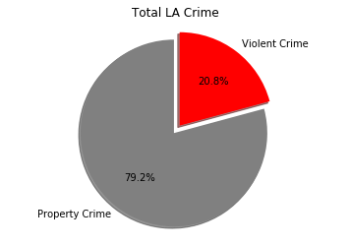
3. Description: Violent vs property

Slide 13
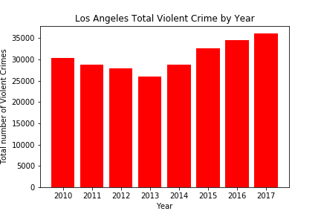
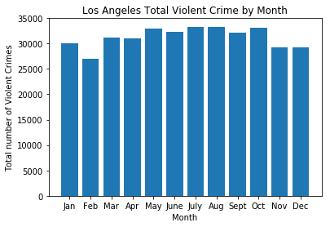
3. Description by year and month

Slide 14
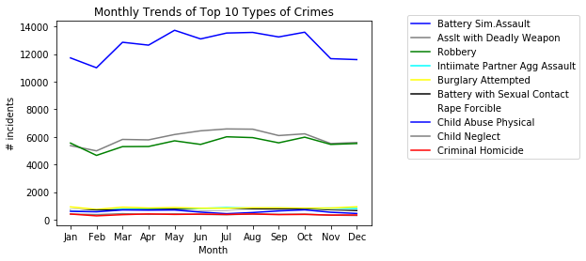
3.Description Monthly Trends for top 10 crimes

Slide 15
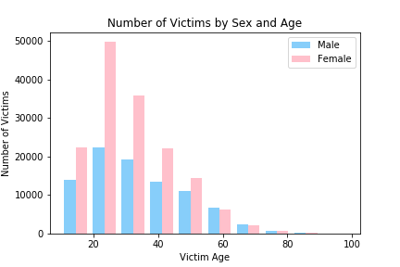
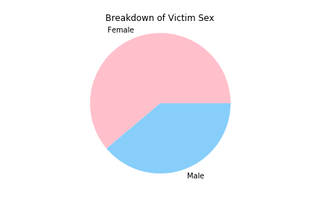
3. Description: Victims by Sex & age

Slide 16
What’s next?
Results
Conclusions
Future Work

Slide 17
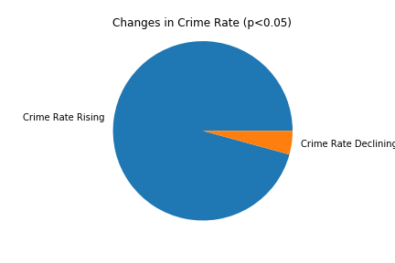
4. Results:

Slide 18
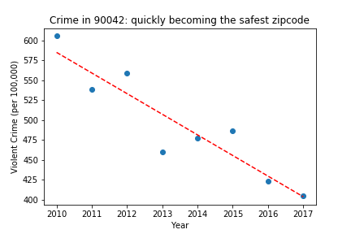
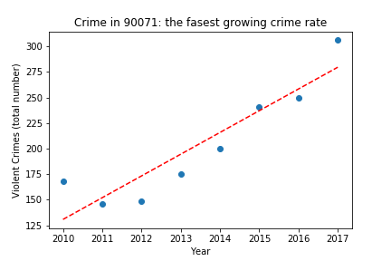
Safe Vs. “not-so-safe” zip-code
4. Results:

Slide 19
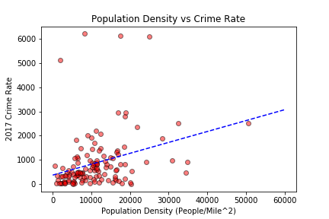
4. Results:
Regression with crime rate:
Does Population Density Matters?

Slide 20
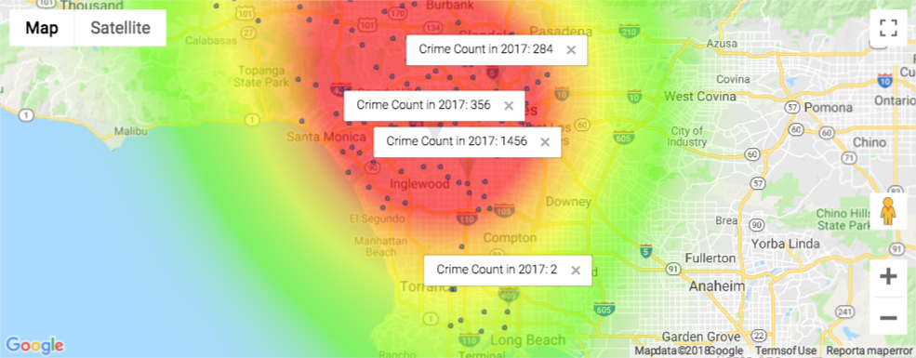
4. Results:
HEAT MAP: Does Race Matter?
Crime count vs Density

Slide 21
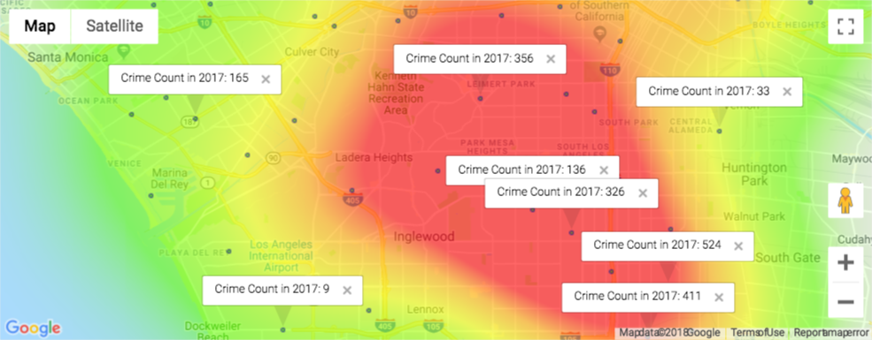
4. Results:
HEAT MAP: Does Race Matter?
Crime count vs Black

Slide 22
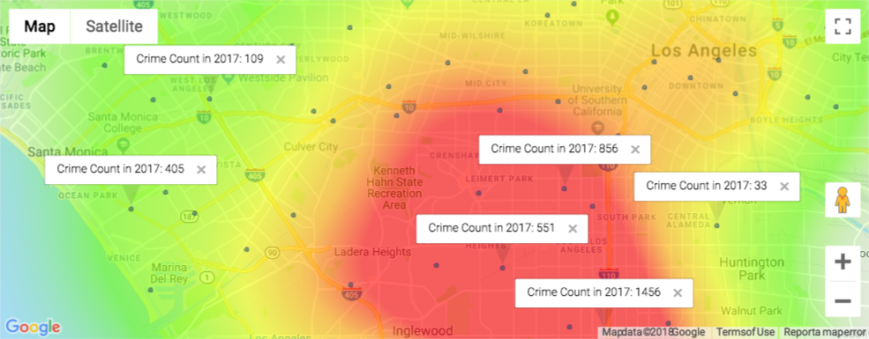
4. Results:
HEAT MAP: Does Race Matter?
Crime count vs Hispanic

Slide 23
Fun Stuff: Interactive Map
Click here!

Slide 24
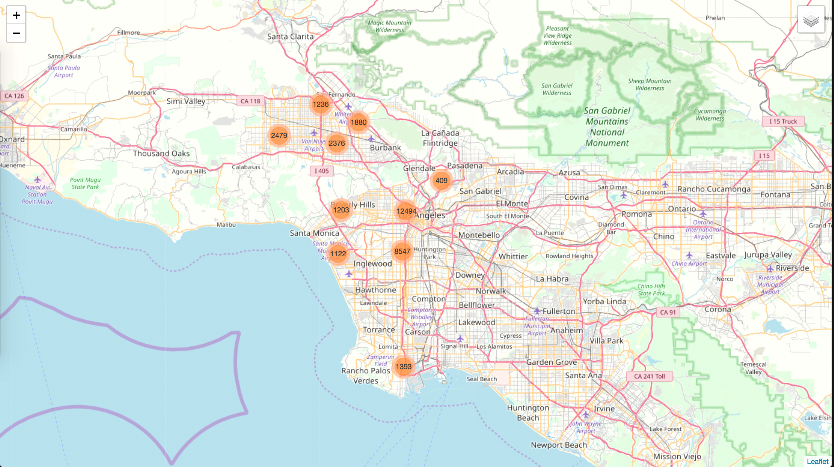

Slide 25
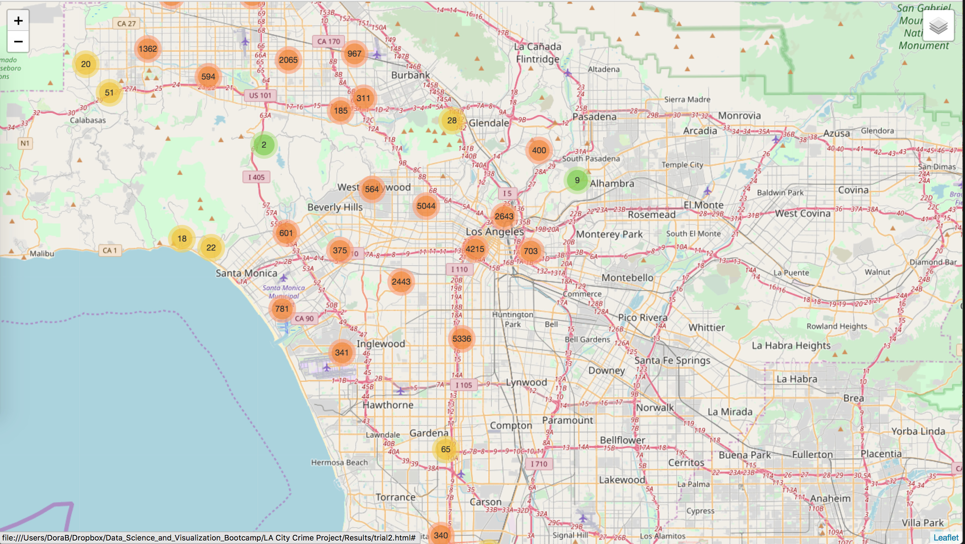

Slide 26
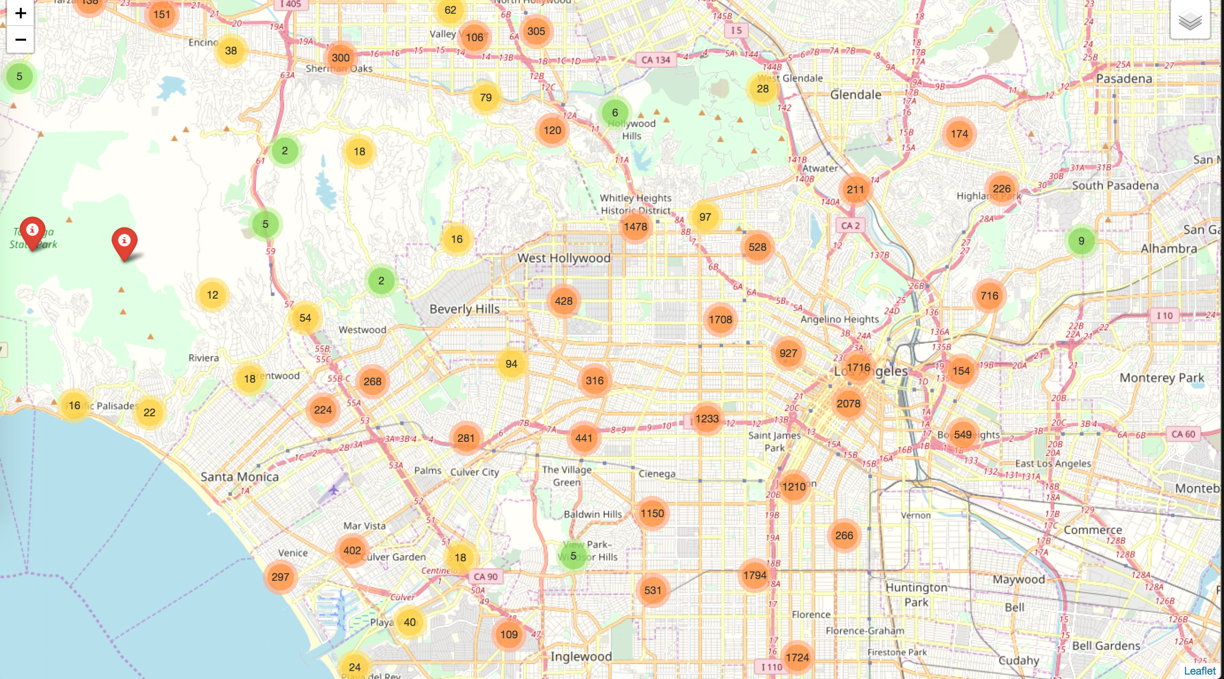

Slide 27
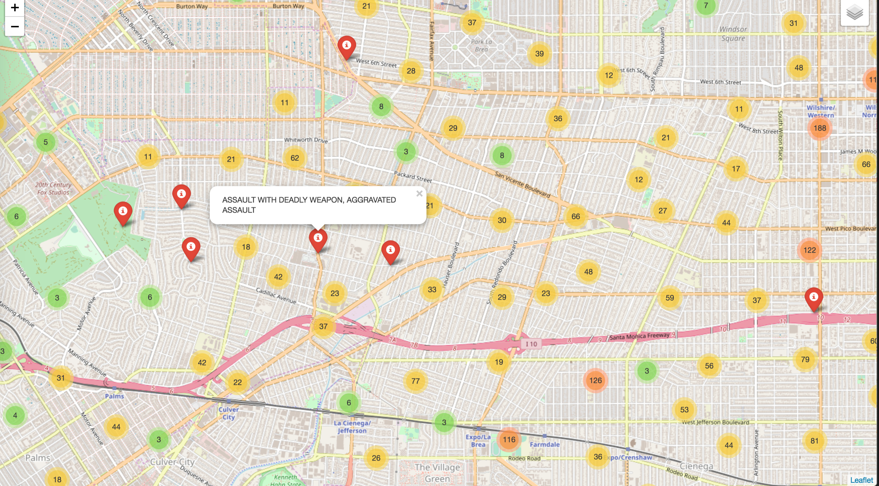

Slide 28
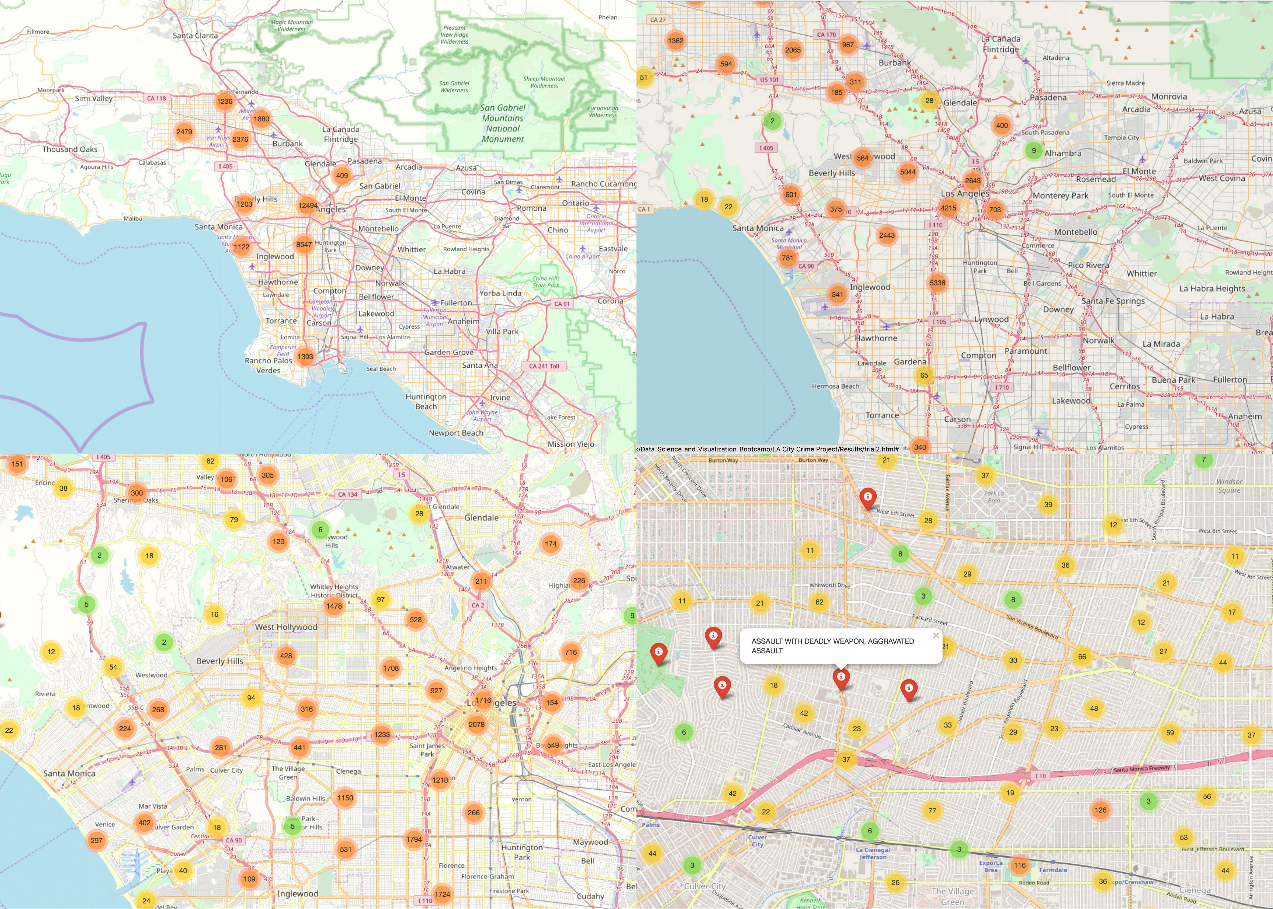

Slide 29
Take Aways.
Are certain months or years more crime prone?
Over the years, 2010 to 2017, violent crimes have increased in Los Angeles.
BUT there is a lack significant monthly variations in incidences. Exceptions being the months of February, November and December which seem to have a relatively lesser frequency.
Can we identify safe versus not-so-far neighborhoods?
In general violent crime rate (as measured by number of incidences per 100,000 individuals) has increased in the city of Los Angeles for the time period 2010 to 2017, at the zip-code level.
There are some zip-codes that have experienced significant decreases in crime rate over this time period, while others have become more unsafe.
Do demographics matter in the incidence of crime?
Population Density (persons per square miles) has a positive correlation with crime rate.
Minority Groups: Anecdotal evidence using heatmaps show that zip-codes with a higher percentages of non-Hispanic Black and Hispanic population may be correlated with higher crime counts.

Slide 30
Future Work
One of the trends that we did not explore was property crime which is reported to have decreased in most counties in CA.
Work on the regressions – Run multivariate regressions.
Create more interactive maps → Choropleth maps with zip-codes shaded for the percentage of minorities.

Slide 31
Citations
U.S. Census Bureau (2016). American Community Survey 1-year estimates. Retrieved from Census Reporter Profile page for Los Angeles, CA.
https://blog.dominodatalab.com/creating-interactive-crime-maps-with-folium/
We are ready to take Questions!
Thanks to Sandip, Jake and Chris!

